Slide 1
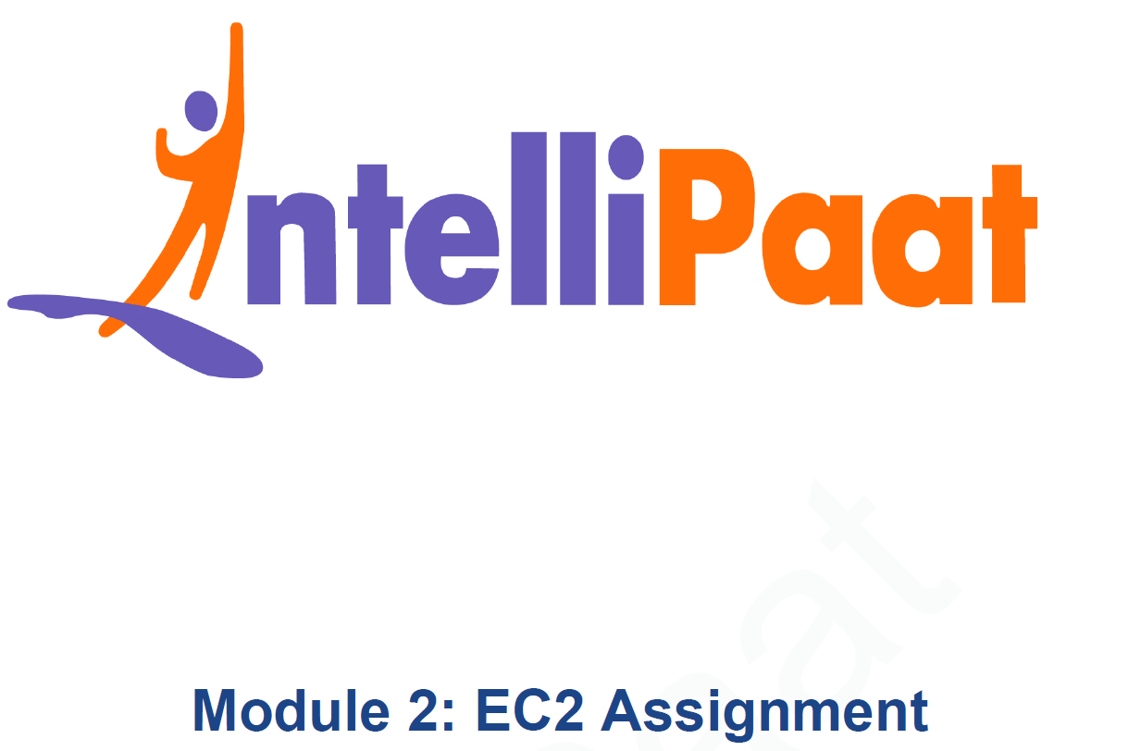
AWS Solutions Architect Training
Module-3: IAM
SIDDHANI VAMSI SAI KUMAR
svsk2376@gmail.com
7678203747

Slide 2
Problem Statement:
You work for XYZ Corporation. To maintain the security of the AWS account and the resources you have been asked to implement a solution that can help easily recognize and monitor the different users.
Users – Tasks:
1. Create 4 IAM users named “Dev1”, “Dev2”, “Test1”, and “Test2”.
2. Create 2 groups named “Dev Team” and “Ops Team”.
3. Add Dev1 and Dev2 to the Dev Team.
4. Add Dev1, Test1 and Test2 to the Ops Team.
Policies – Tasks: 1. Create policy number 1 which lets the users to: a. Access S3 completely b. Only create EC2 instances c. Full access to RDS 2. Create a policy number 2 which allows the users to: a. Access CloudWatch and billing completely b. Can only list EC2 and S3 resources 3. Attach policy number 1 to the Dev Team from task 1 4. Attach policy number 2 to Ops Team from task 1 | Roles – Tasks: 1. Create a role which only lets user1 and user2 from task 1 to have complete access to VPCs and DynamoDB. 2. Login into user1 and shift to the role to test out the feature.

Slide 3
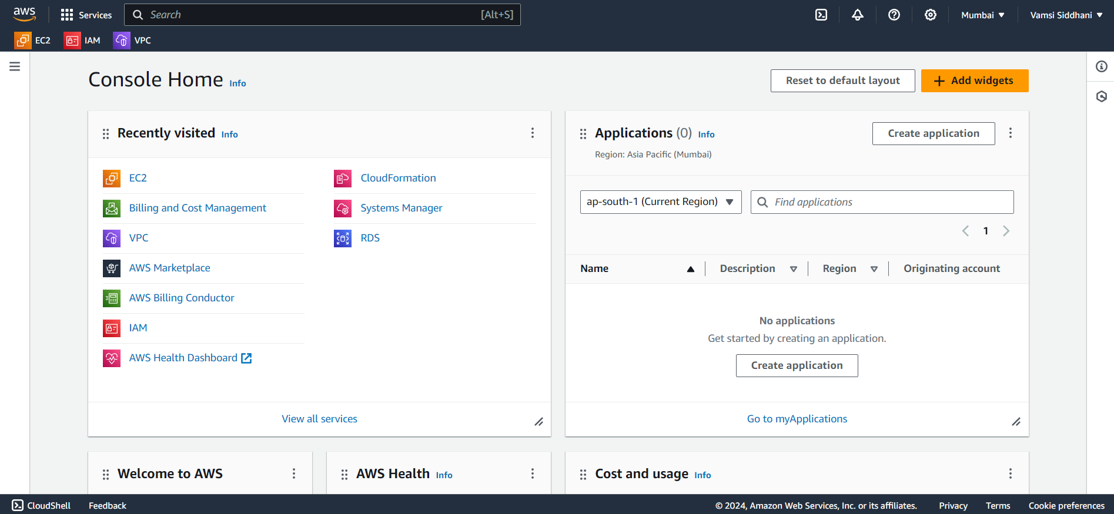
TASK – USERS & GROUPS
Let’s create the 4 users namely Dev1, Dev2, Test1 and Test2. Go to IAM.
Click on IAM

Slide 4
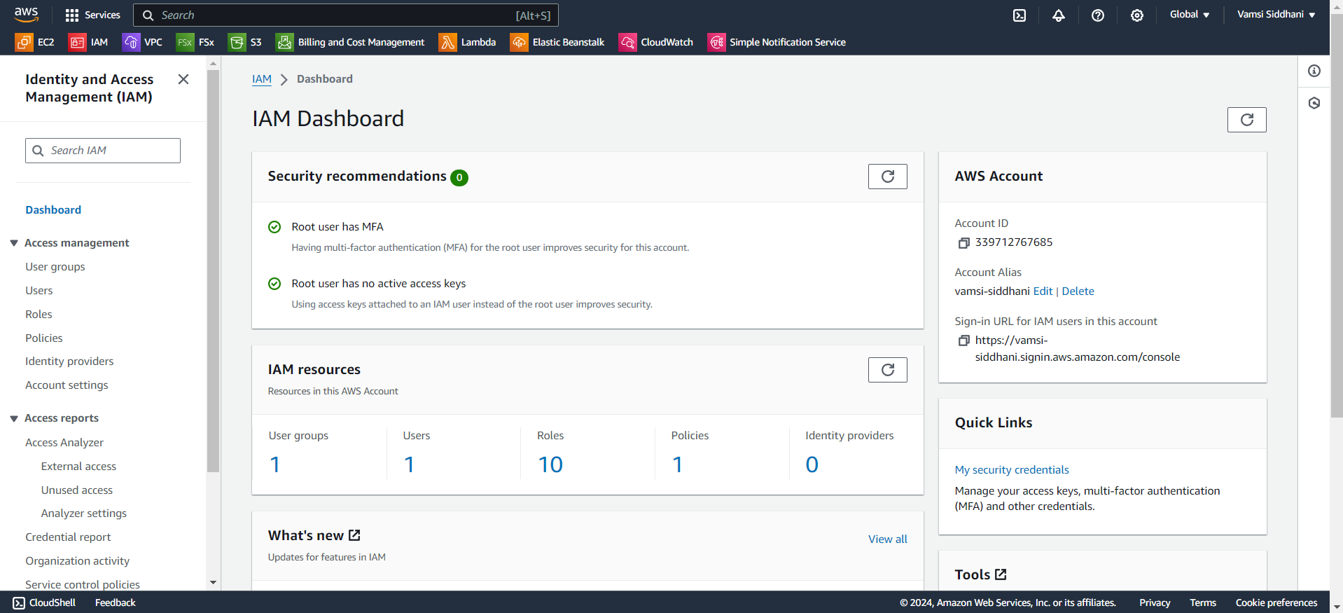
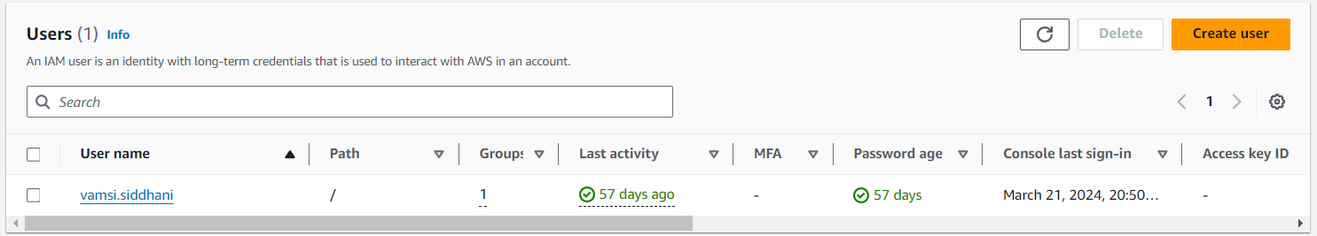
TASK – USERS & GROUPS
Click on Users.
Click on Create user.

Slide 5
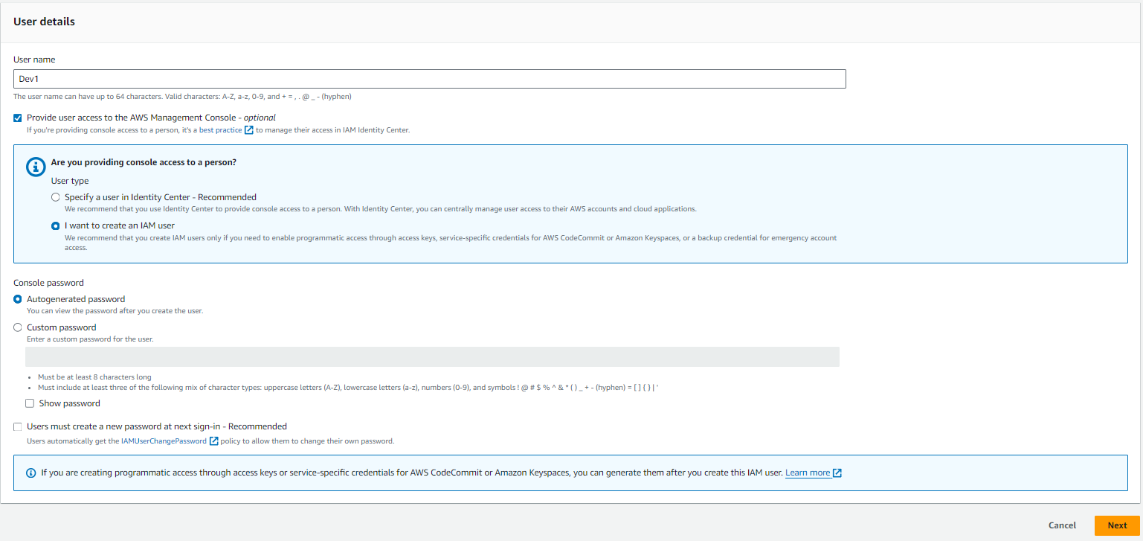
TASK – USERS & GROUPS
Enter the name of the first user (Dev1)
We’ve to create an IAM user
I’ll use the auto generated password and that user no need to create a new password at next sign-in
Click on Next

Slide 6
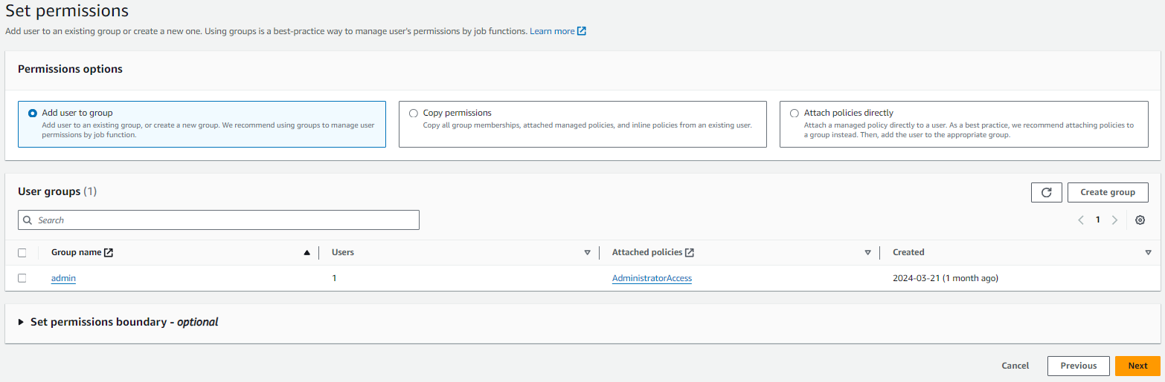
TASK – USERS & GROUPS
For the time being I’m not attaching any policies to this user. Simply Click on Next.

Slide 7
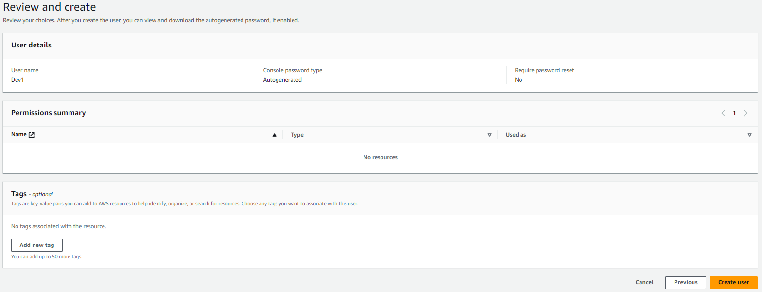
TASK – USERS & GROUPS
Click on Create

Slide 8
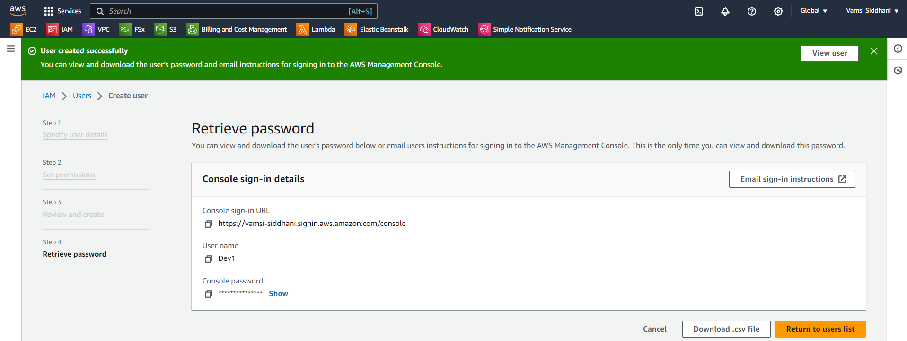
TASK – USERS & GROUPS
Download the CSV file and keep it in a safe place.
Go to users list

Slide 9
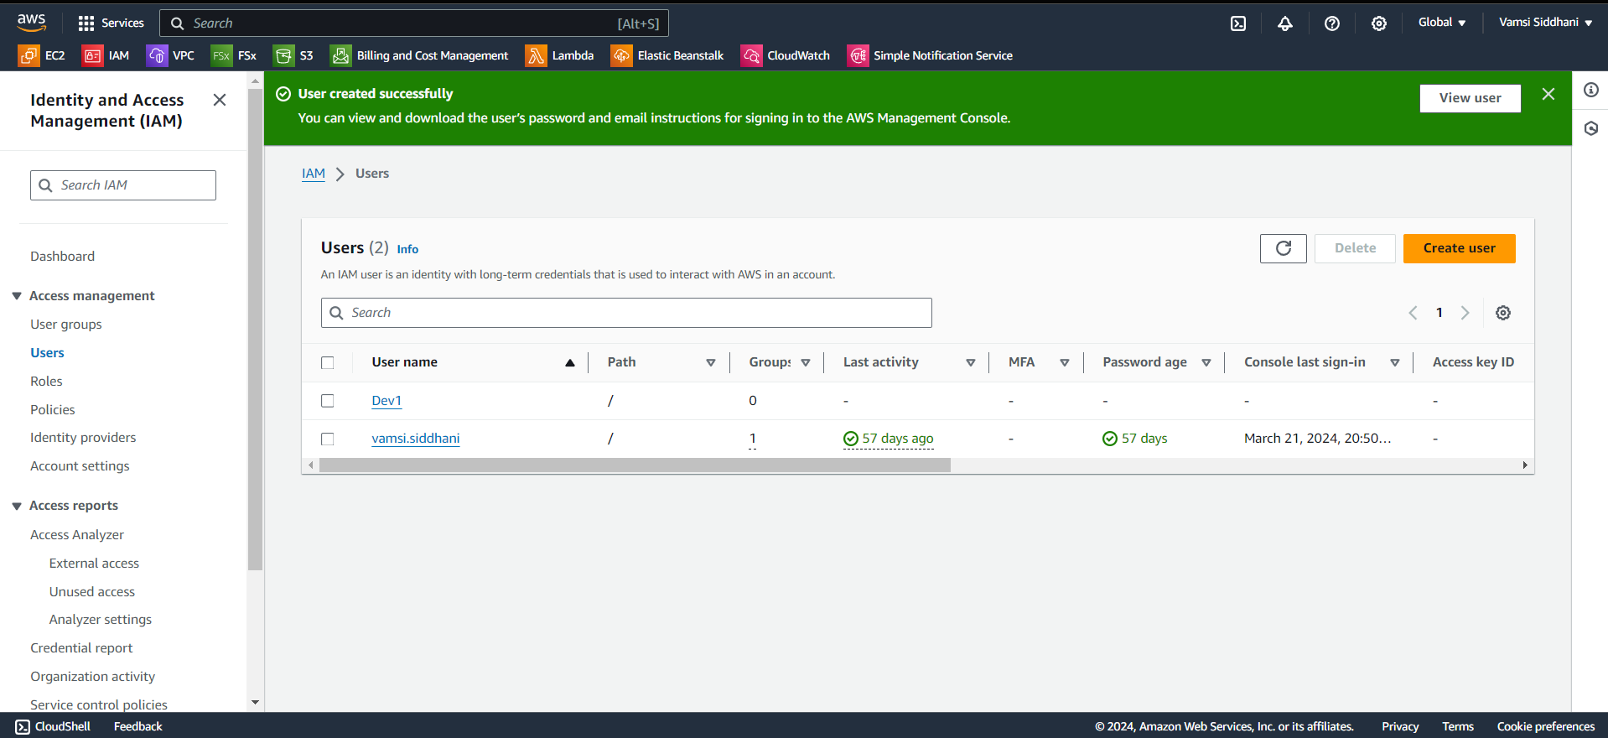
TASK – USERS & GROUPS
Our first user Dev1 is created. Similarly we’ll create the remaining 3 users.

Slide 10
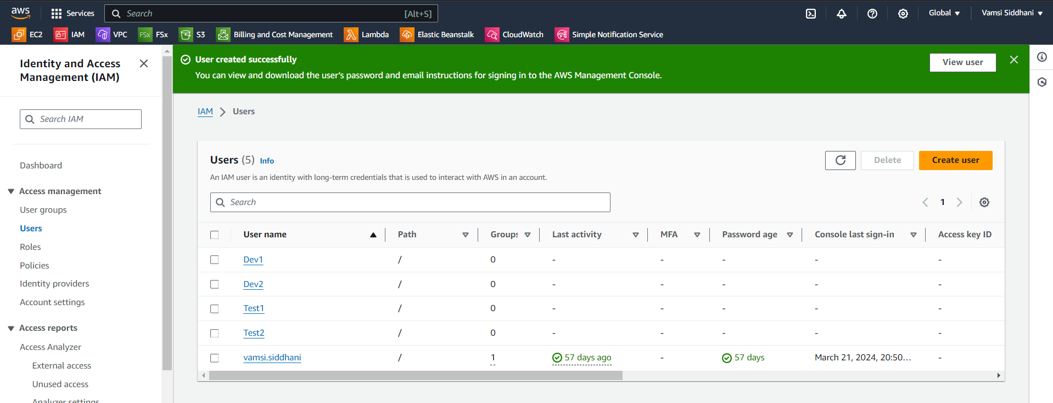
TASK – USERS & GROUPS
Our 4 users are ready. Let’s move on to the next task. We’ve to create 2 groups.
Click on User groups.

Slide 11
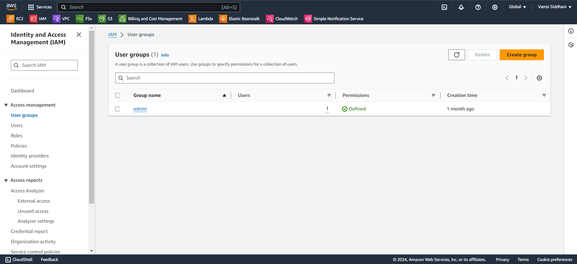
TASK – USERS & GROUPS
Click on create

Slide 12
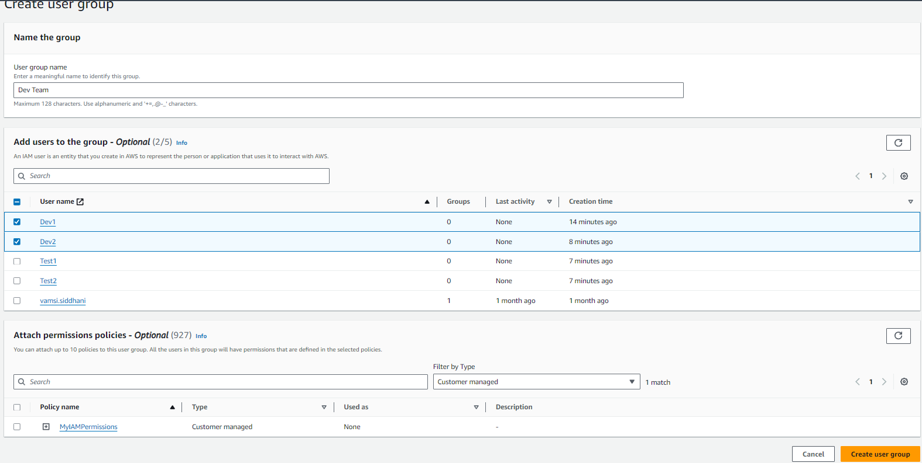
TASK – USERS & GROUPS
Our first group is for Dev Team
We’ve to add Dev1 and Dev2 to Dev Team
For the time being I’m not attaching any policies to this user. Simply Click on Create.

Slide 13
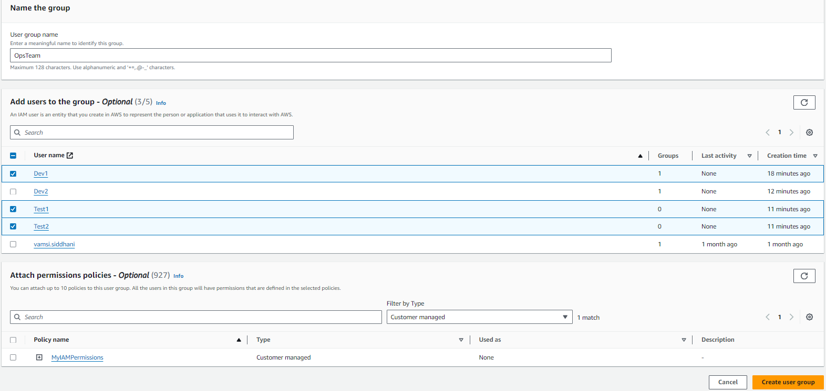
TASK – USERS & GROUPS
Similarly I created another group OpsTeam and added users Dev1, Test1 and Test2

Slide 14
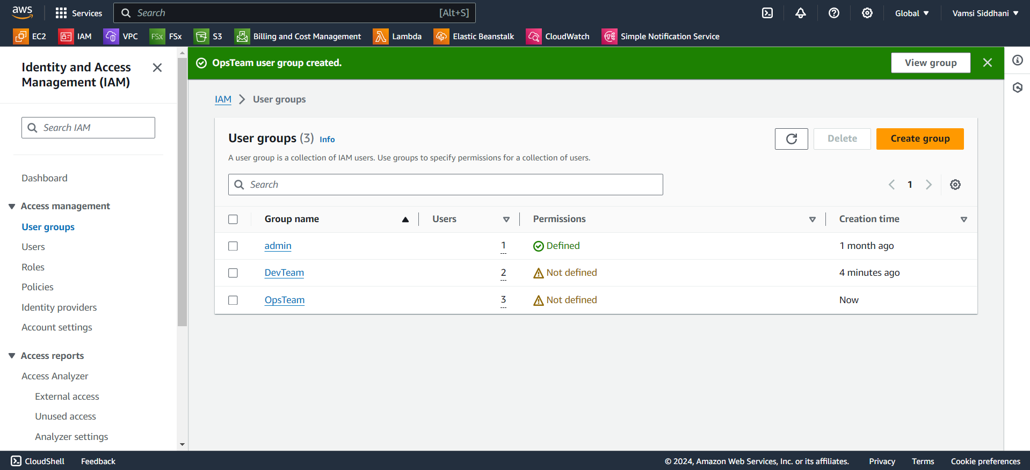
TASK – USERS & GROUPS
Our users and groups are created. We’re ready to move to next task i.e. we’ll attach policies to these.
Policy number 1 should contain:
a. Complete S3 Access
b. Only EC2 instances creation
c. Full access to RDS
Click on Policies

Slide 15
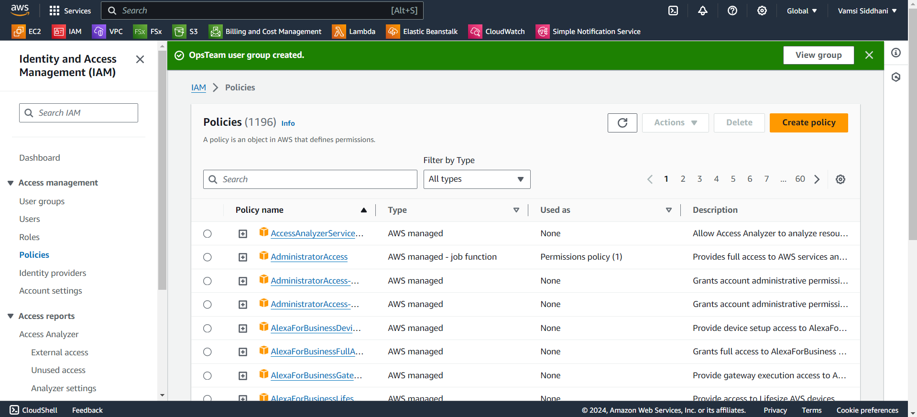
TASK – POLICIES
Click on Create Policy

Slide 16
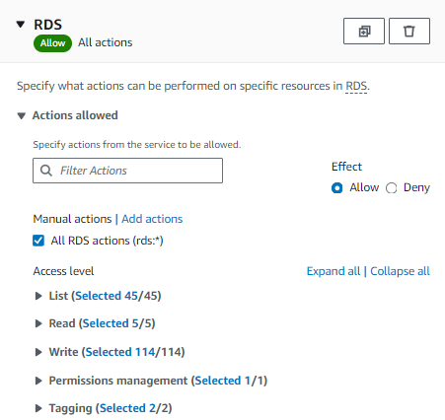
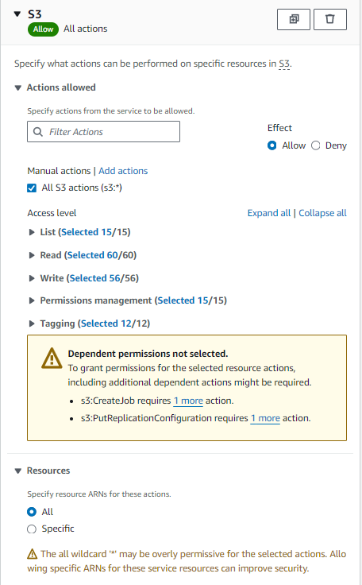
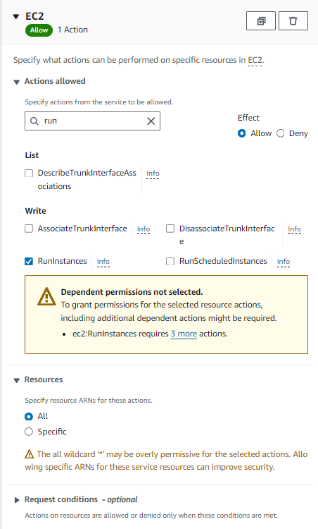
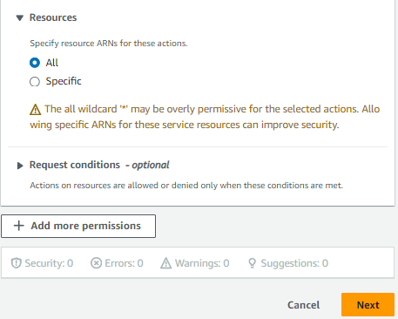
TASK – POLICIES
Click on Next

Slide 17
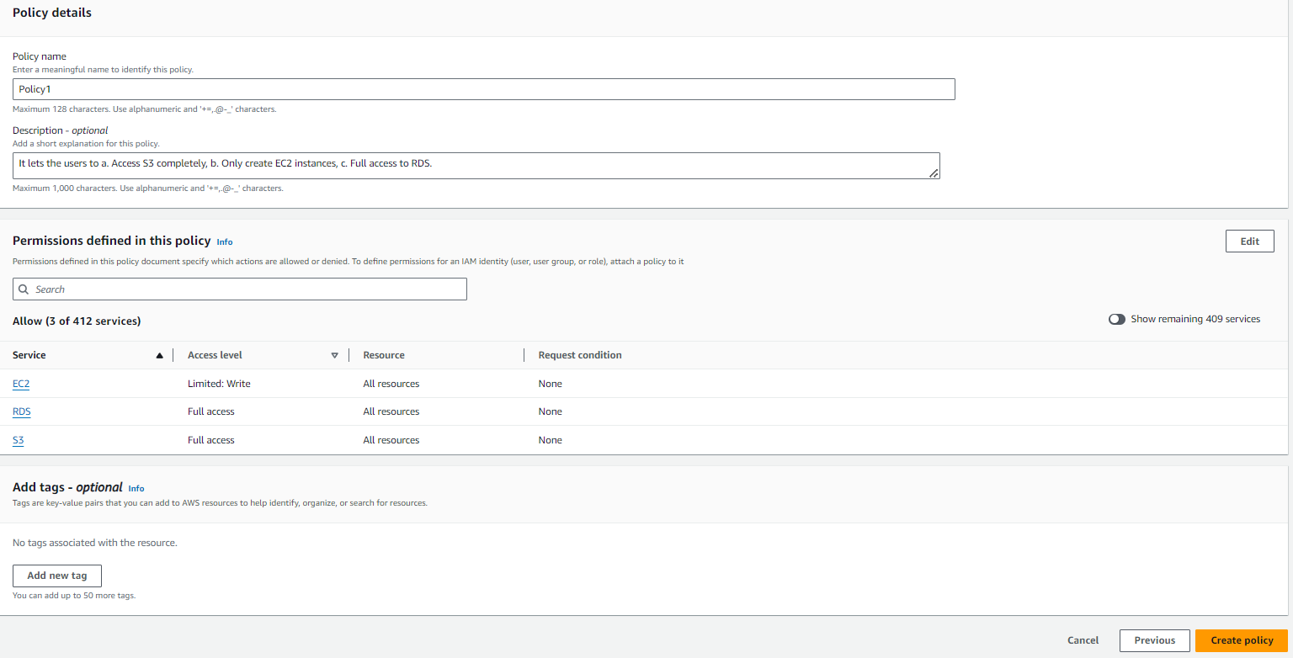
TASK – POLICIES
Review the settings and click on Create

Slide 18
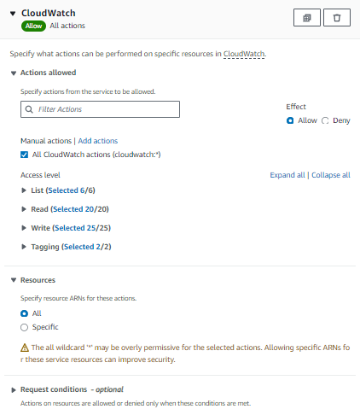
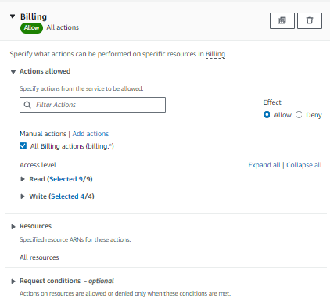
TASK – POLICIES
Similarly we’ll create the second policy

Slide 19
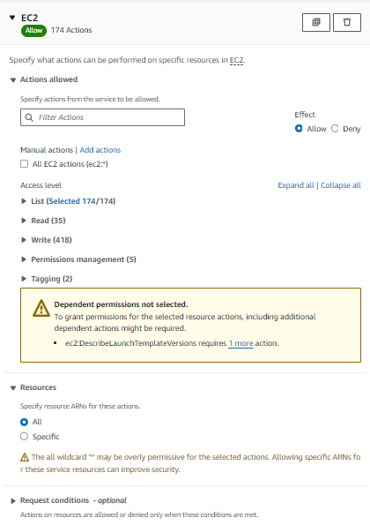
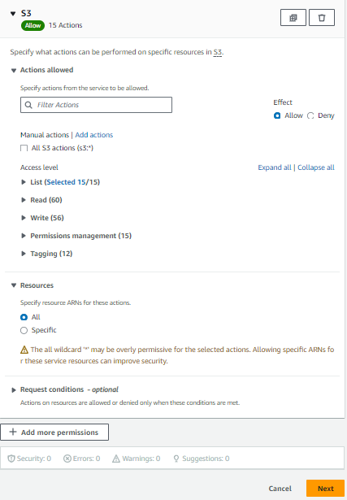
TASK – POLICIES
Click on Next

Slide 20
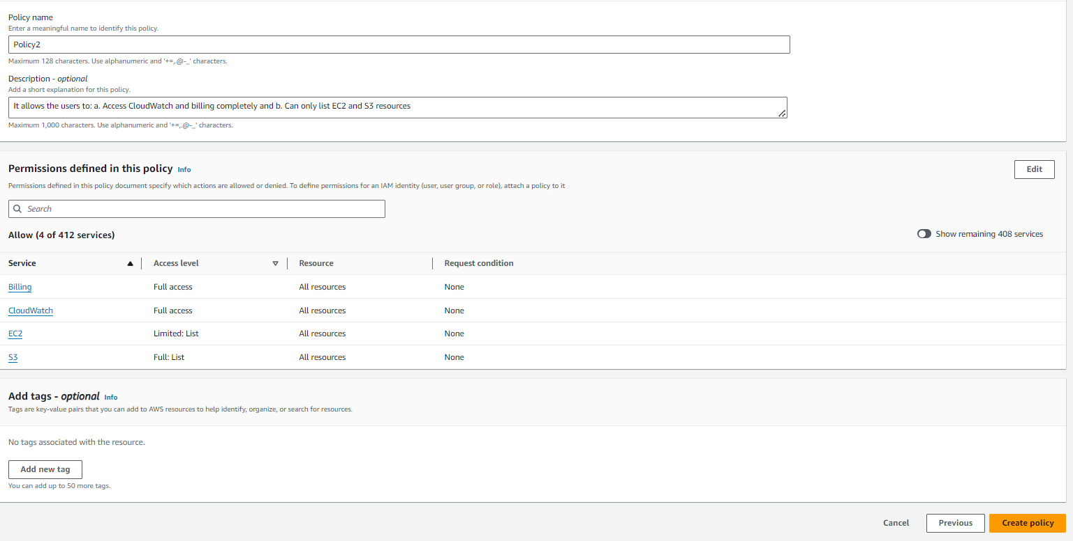
TASK – POLICIES
Review the settings and click on Create

Slide 21
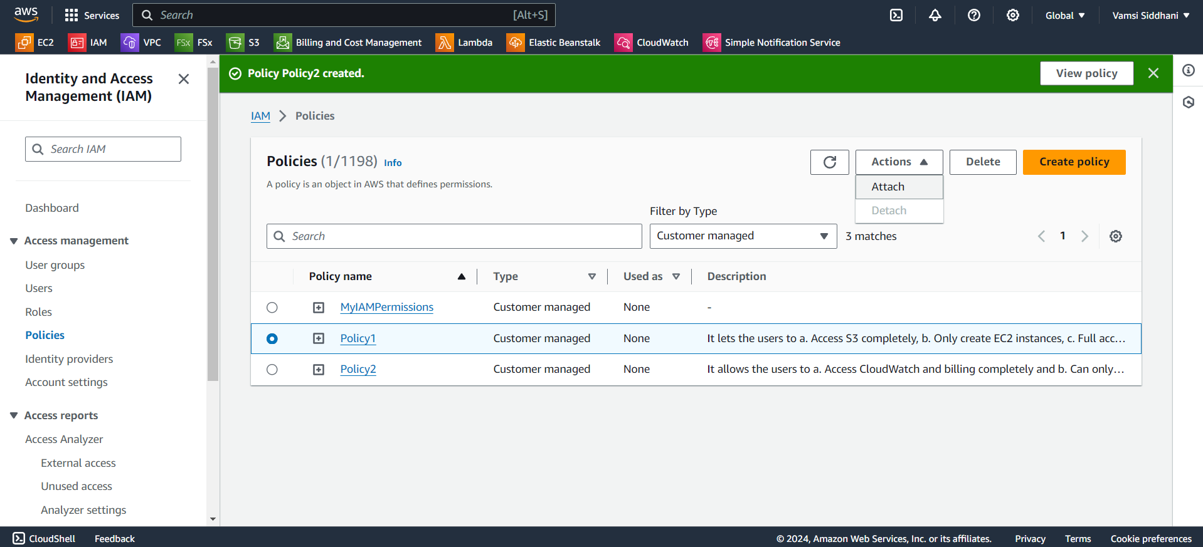
TASK – POLICIES
Policies are created. Let’s attach these policies to the groups as follows.
Policy1 to DevTeam and Policy2 to OpsTeam
Select policy1 and Click on Actions → Attach

Slide 22
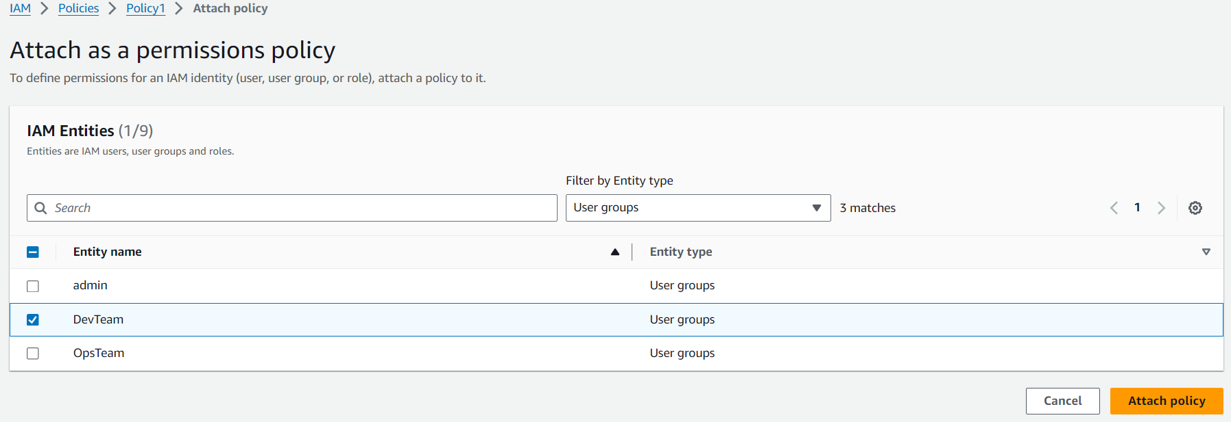
TASK – POLICIES
Add this policy to DevTeam and click on Attach

Slide 23
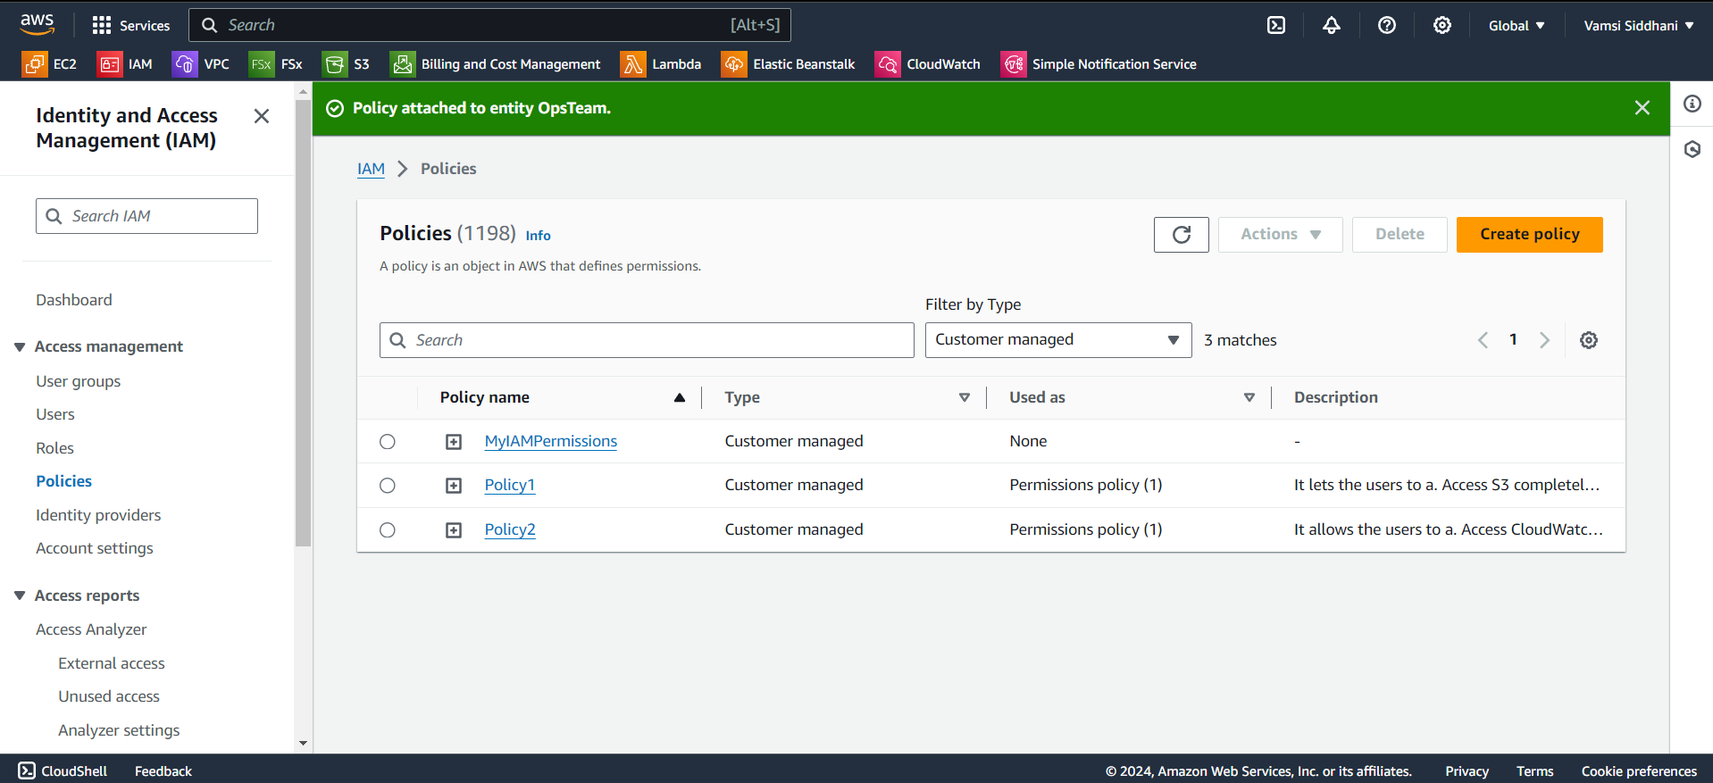
TASK – POLICIES
Similarly I attached, Policy2 to OpsTeam

Slide 24
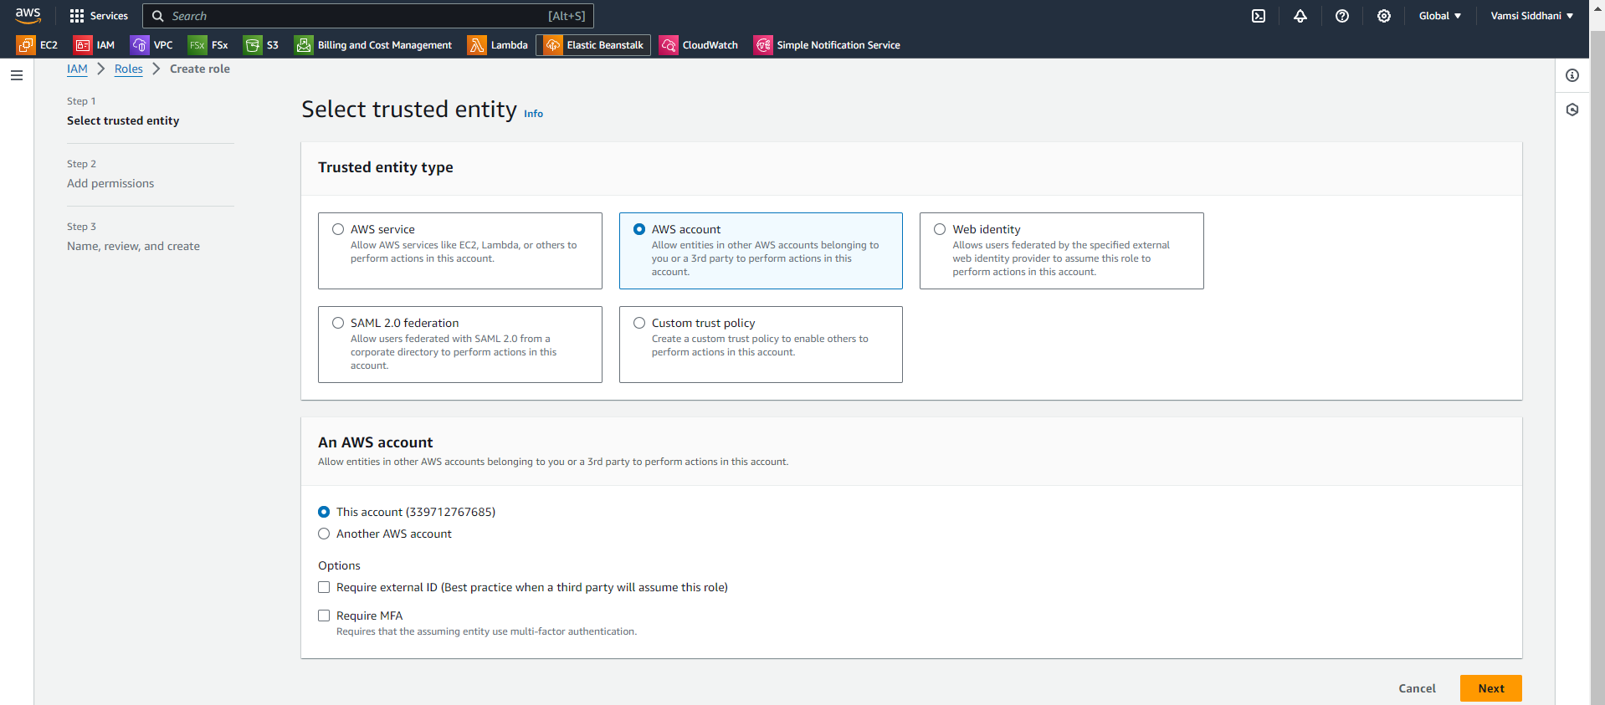
TASK – ROLES
For the next task, let’s Create a role which only lets user1 and user2 from task 1 to have complete access to VPCs and DynamoDB.
Click on Roles → Create Role
Select AWS Account and Choose this account and click on Next

Slide 25
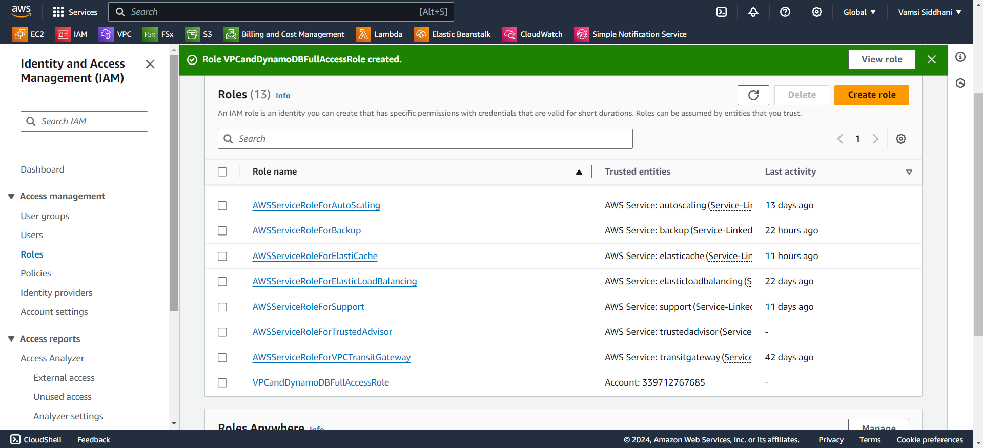
TASK – ROLES
Search in the policies and add AmazonVPCFullAccess and AmazonDynamoDBFullAccess. Click on Next.
Name: VPCandDynamoDBFullAccessRole → Click on Create Role.
Role is created.

Slide 26
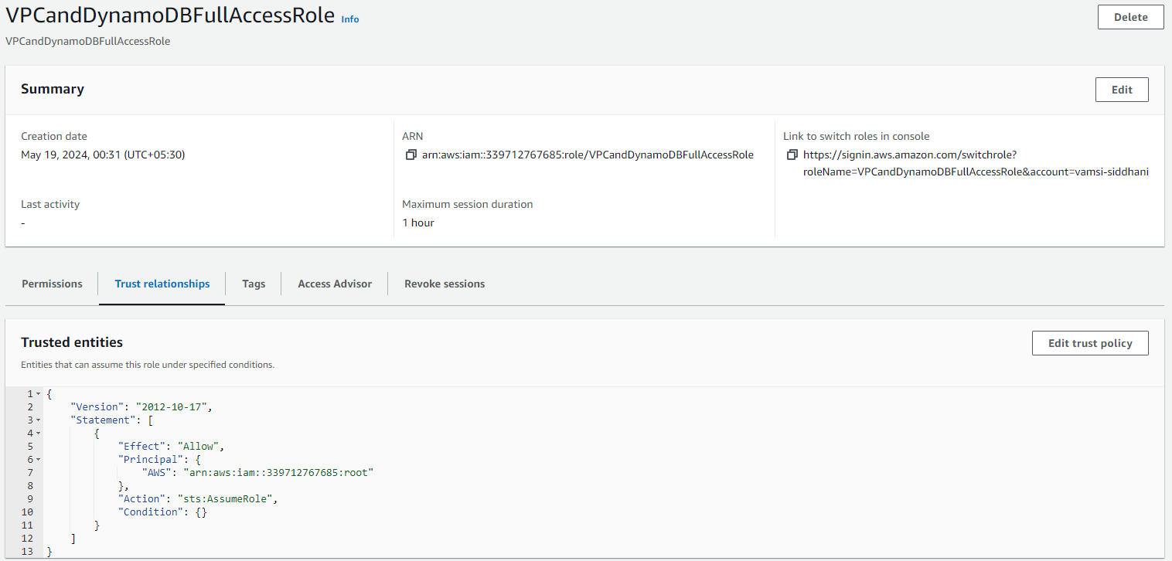
TASK – ROLES
Now we need to add users to this role.
Go to Roles → VPCandDynamoDBFullAccessRole
Go to Trust relationships
Click on Edit

Slide 27
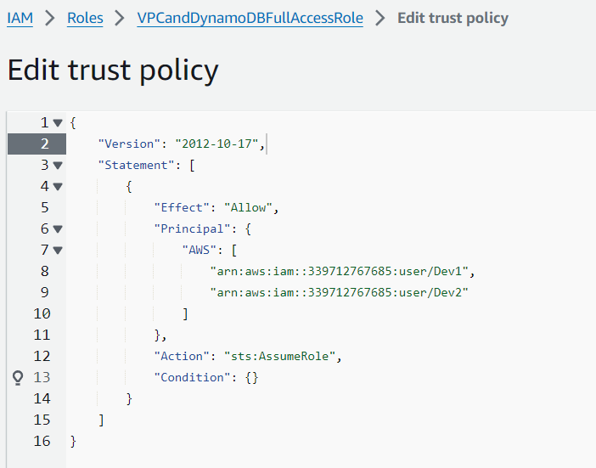
TASK – ROLES
Add ARNs of the user1 and user2 and click on Update Policy.

Slide 28
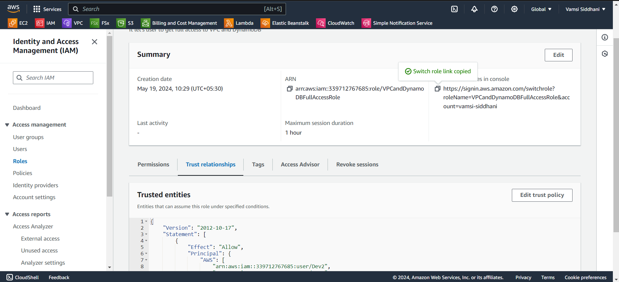
TASK – ROLES
Let’s switch the role using the link here. Open it in new incognito window.

Slide 29
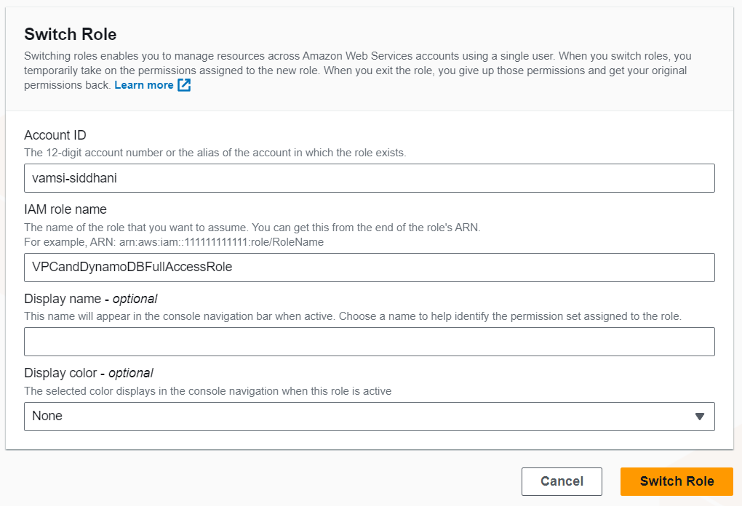
TASK – ROLES
Click on Switch Role

Slide 30
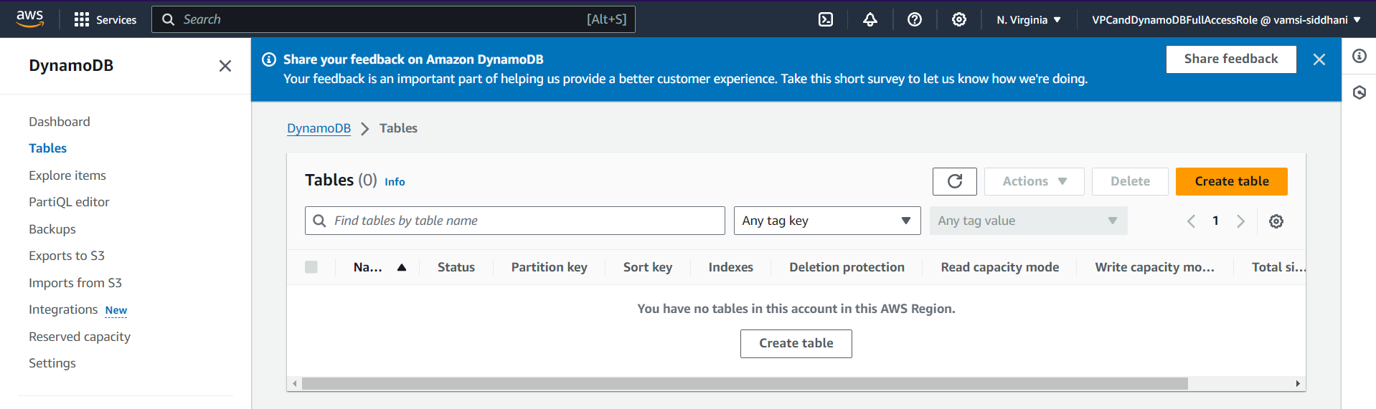
TASK – ROLES
Navigate to DynamoDB and we can see that the role name is present in the account name.
Also it is able to fetch the table details and showing that there are no tables in this account and no permission errors.

Slide 31
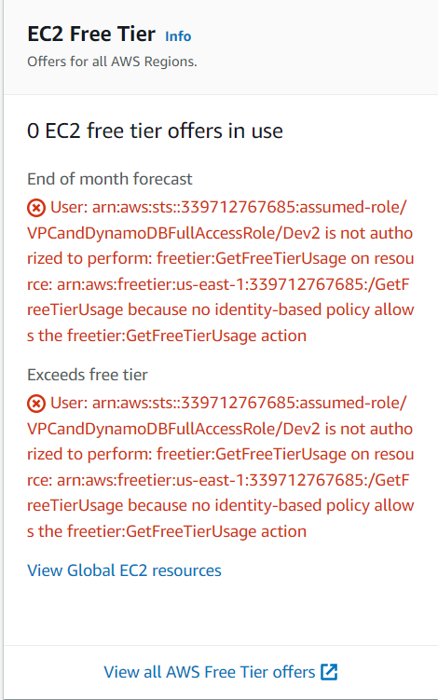
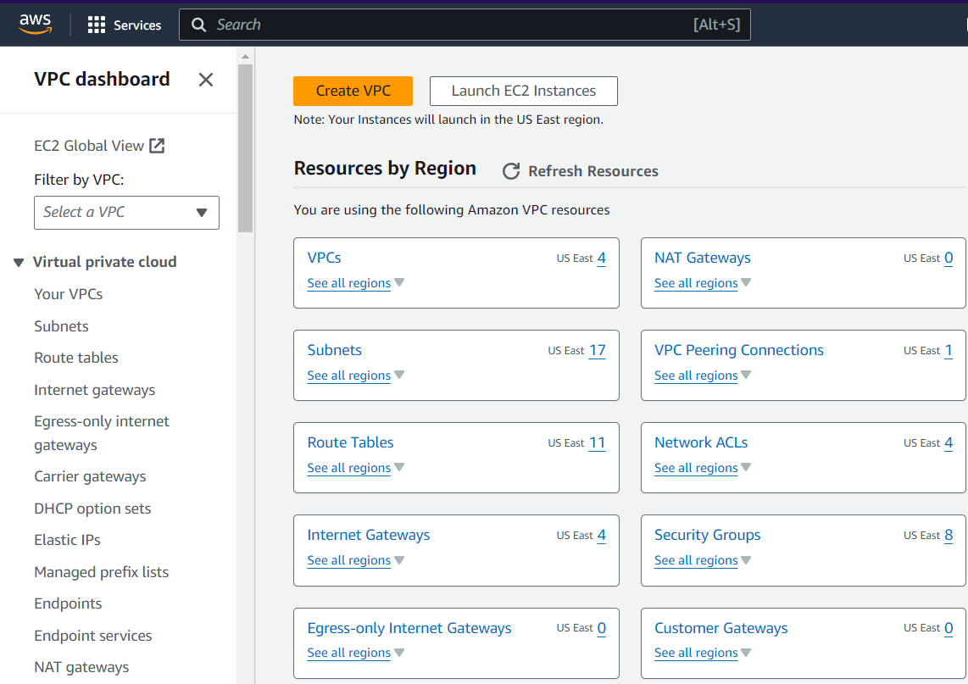
TASK – ROLES
We’ve not provided permission to EC2.
So it is showing permission errors
Similary navigate to VPC and see that it is fully accessible.
It is able to fetch the details and no permission errors.

Slide 32
Summary
Created users and groups. Added those users to the appropriate groups.
Created 2 policies for different use cases. Attached them to the respective groups asked in the problem statement.
Created a role to allow 2 users to have complete VPC and DynamoDB access.
Logged in to User1 (Dev1) and verified that it is working as expected.

Slide 33

Thank You.

